Slide 1
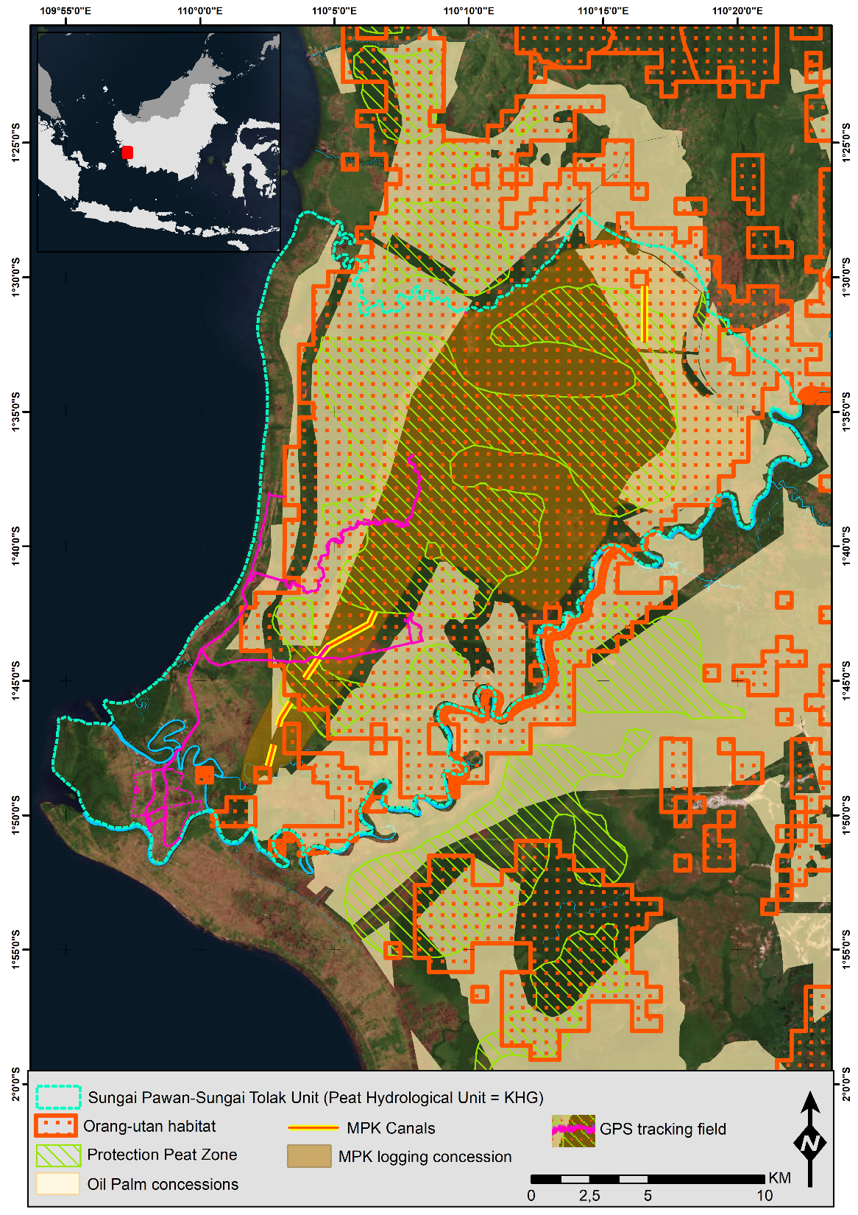
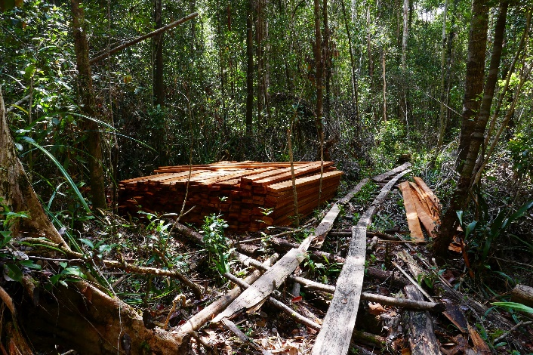
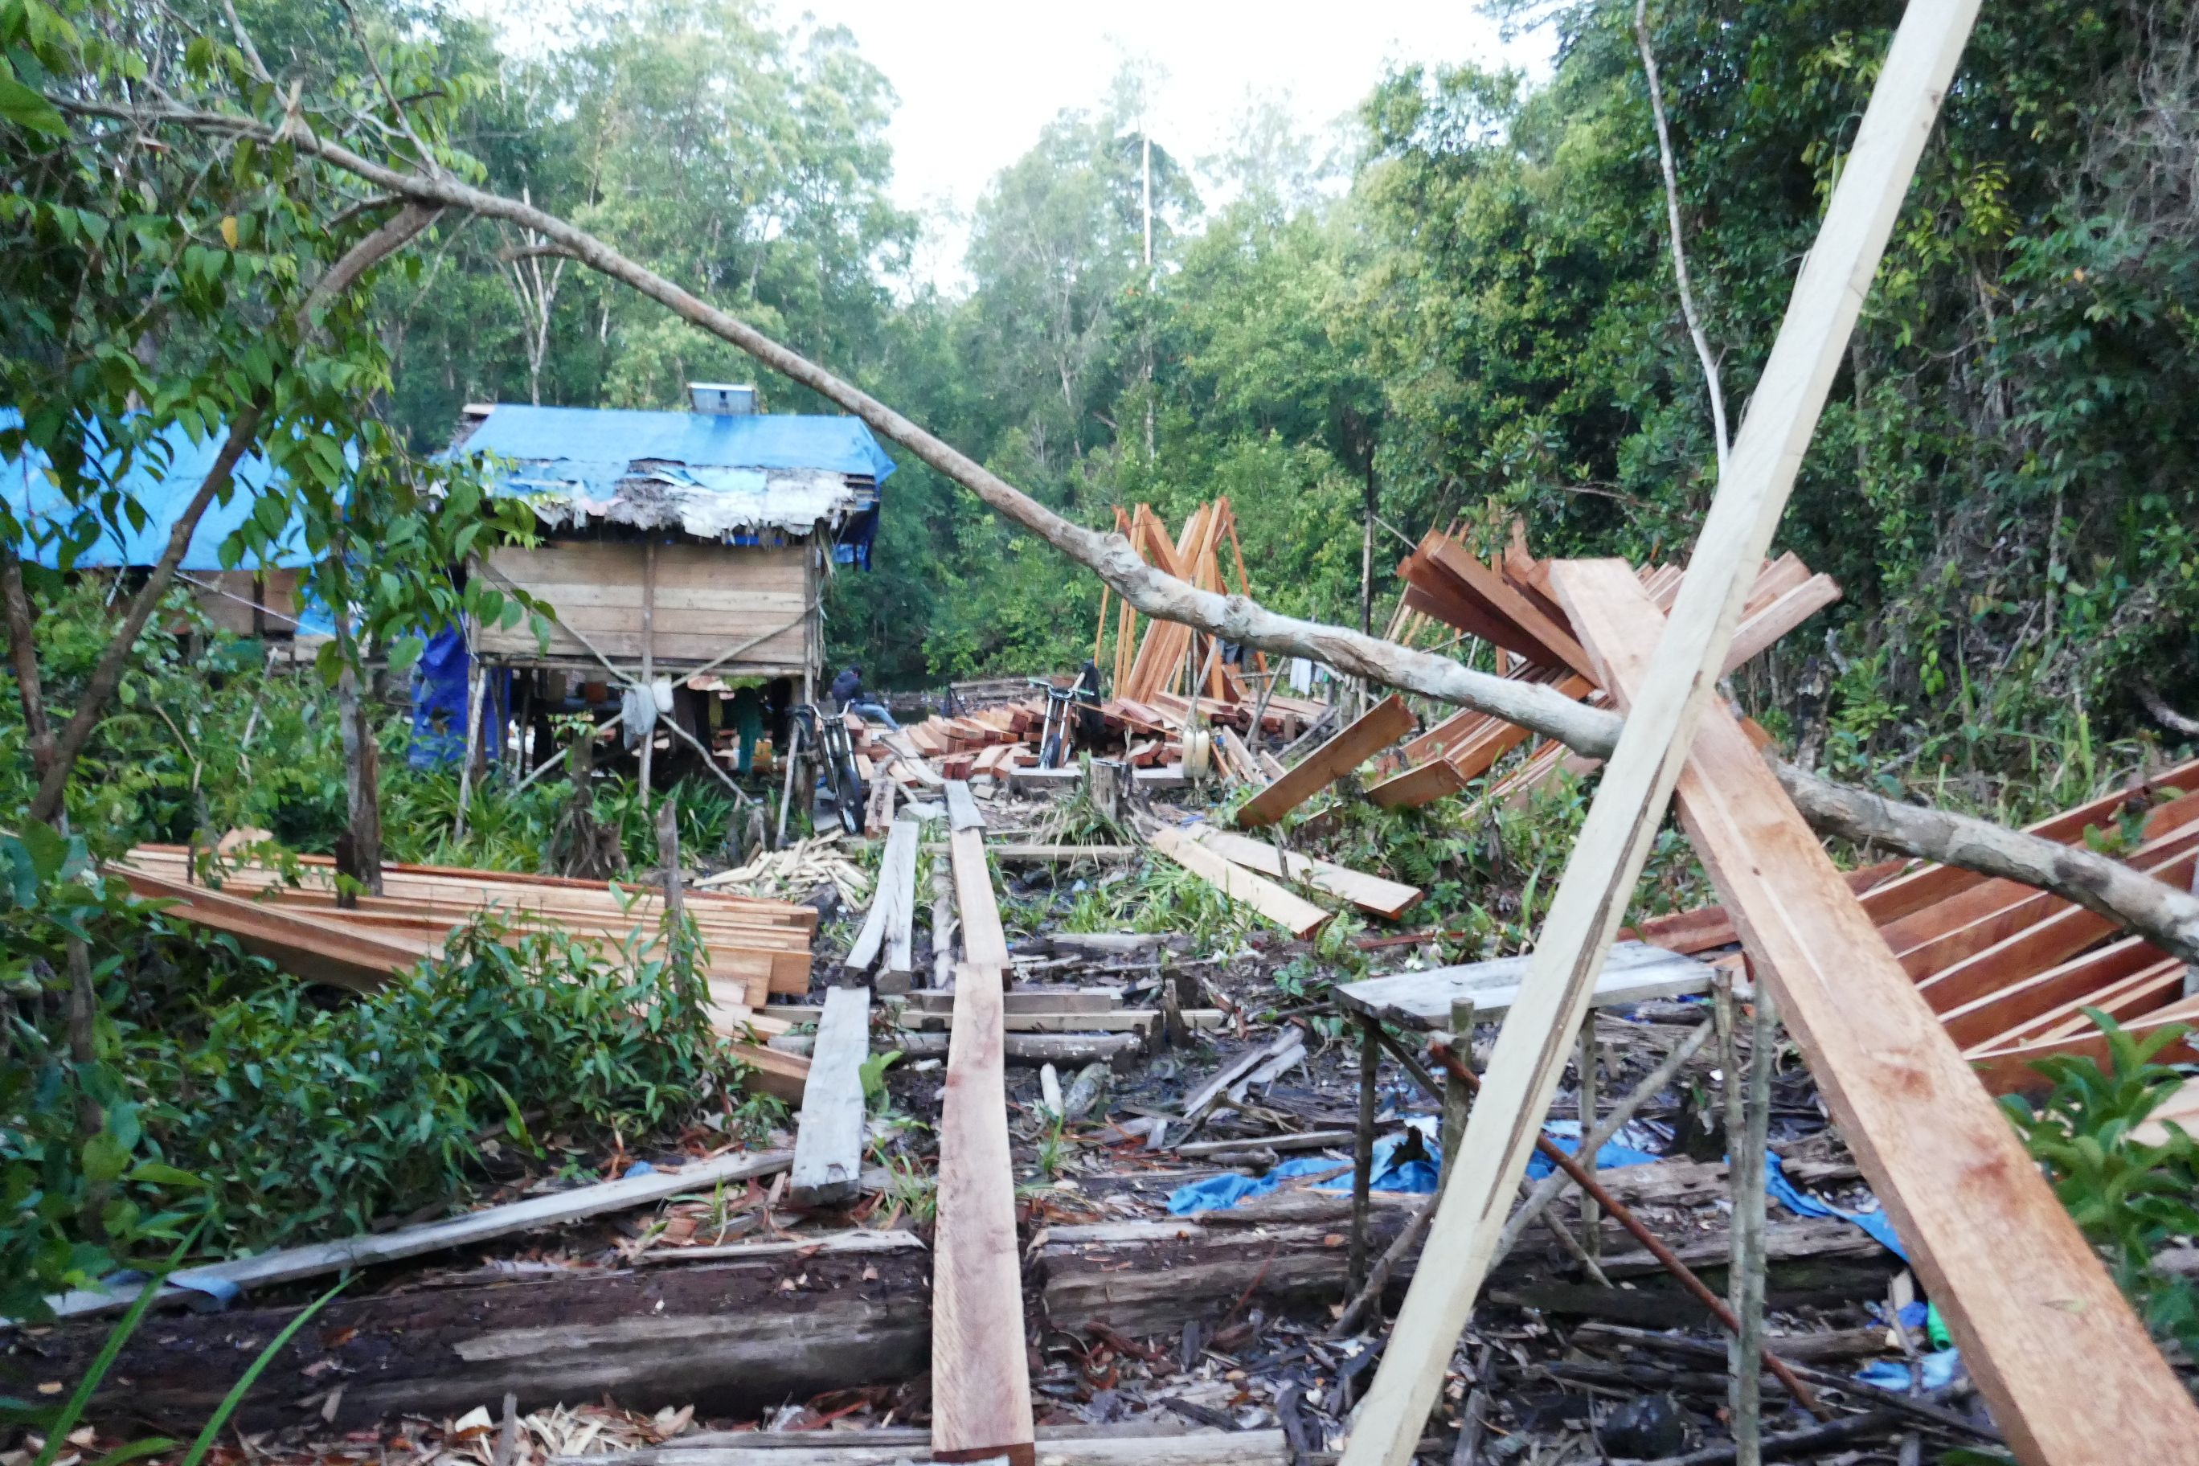
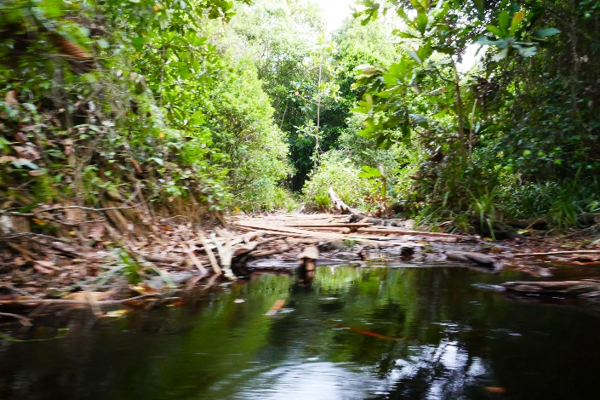
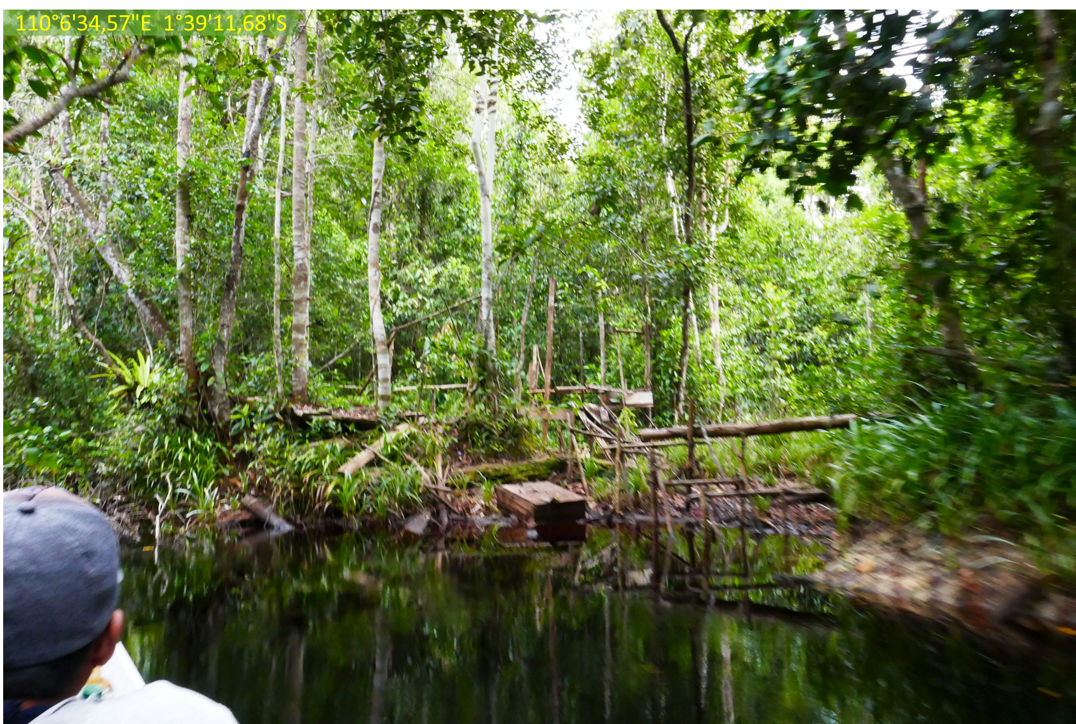
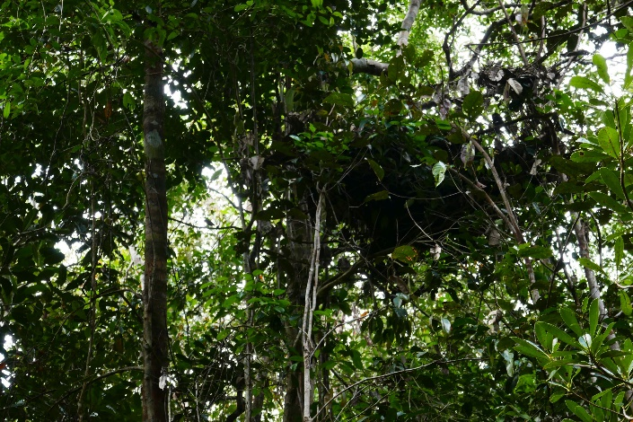
110°7'6,374"E 1°39'5,604"S
Date: 02/03/2018
Date: 02/03/2018
Date: 27/02/2018
110°6'34,57"E 1°39'11,68"S
Date: 27/02/2018
Date: 28/02/2018

Slide 2
Date: 02/03/2018
A main camp of illegal logging activity inside PT MPK concession only accessible through Tempurukan river, Tempurukan village

Slide 3
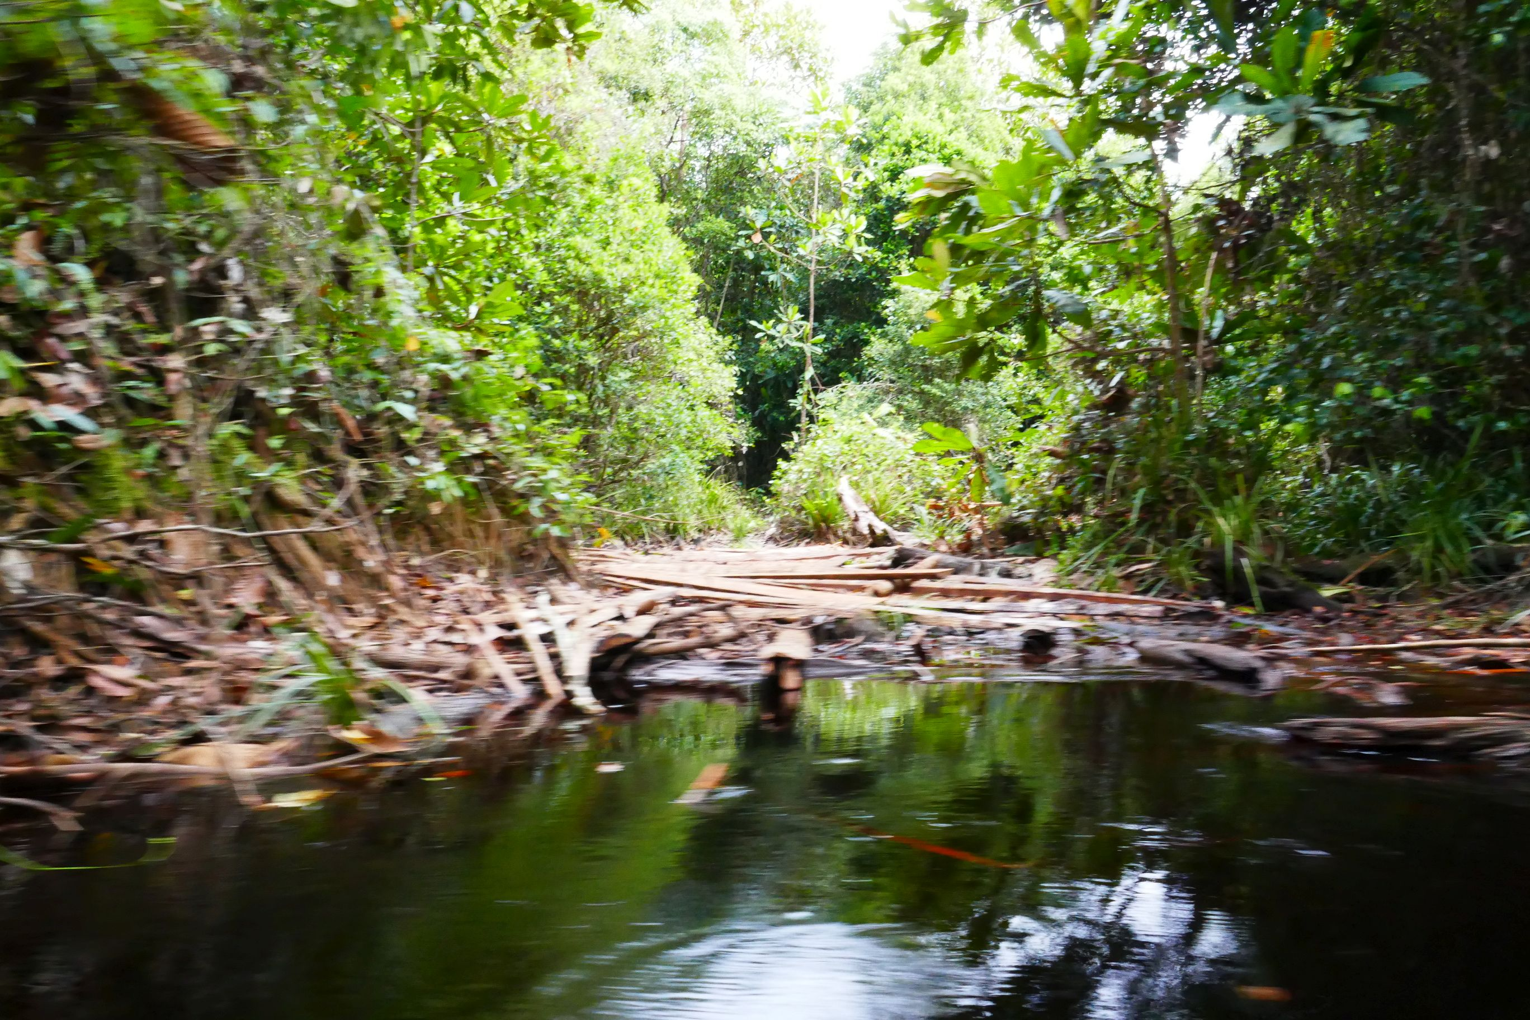
Date: 27/02/2018
An Illegal logging road accessed through
Tempurukan river, Tempurukan village

Slide 4
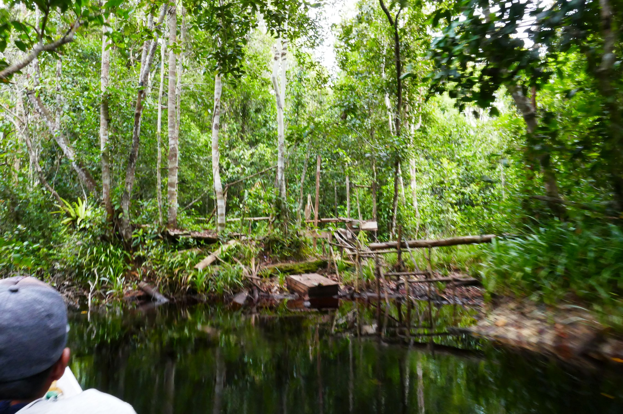
110°6'34,57"E 1°39'11,68"S
Date: 27/02/2018
On Tempurukan river used for illegal timber to main illegal logging camp inside MPK concession

Slide 5
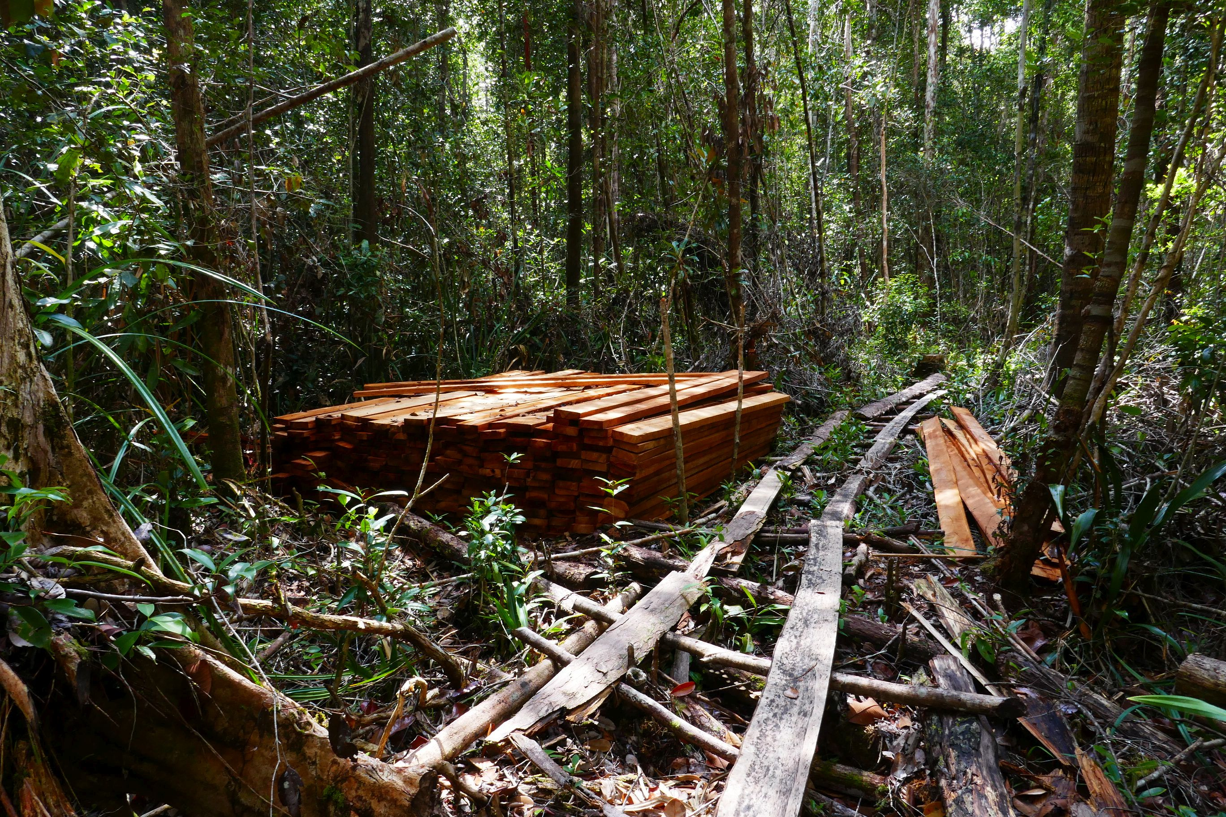
110°7'6,374"E 1°39'5,604"S
Date: 02/03/2018
Timber (Chin wood) piles from Illegal logging inside PT MPK concession

Slide 6
Date: 28/02/2018
An orangutan nest beside Illegal logging road inside PT MPK concession

